Slide 1
Google 2.0

Slide 2
Group Members
Muneeb Aijaz
Sami Mansoor Alavi
Mariam Naseem
Mashhood Ijaz

Slide 3
Contents
Dataset
Technologies Used
Crawler
Parser
Forward vs Reverse Indexing
Forward Indexing
Reverse Indexing
Page Ranking Criteria
Single Word Searching
Multiple Words Searching
GUI
Commit History on BitBucket.org

Slide 4
Dataset
Wikipedia Dataset
2008 version
Used 50001 out of 109832 html files

Slide 5
Technologies Used
Beautiful Soup 4
Tkinter
SQLite 3
Python 3.7
Regex

Slide 6
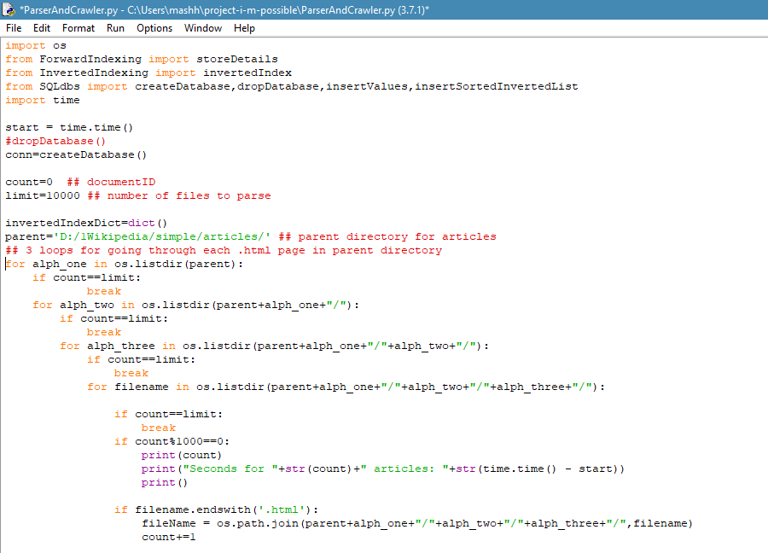
Crawler

Slide 7
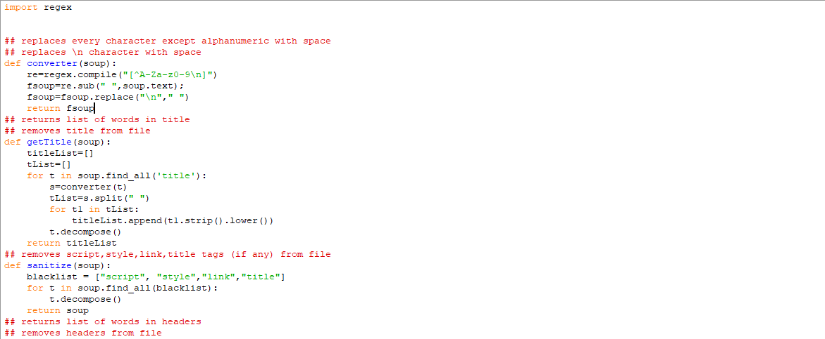
Parser
Beautiful Soup was used for parsing.

Slide 8
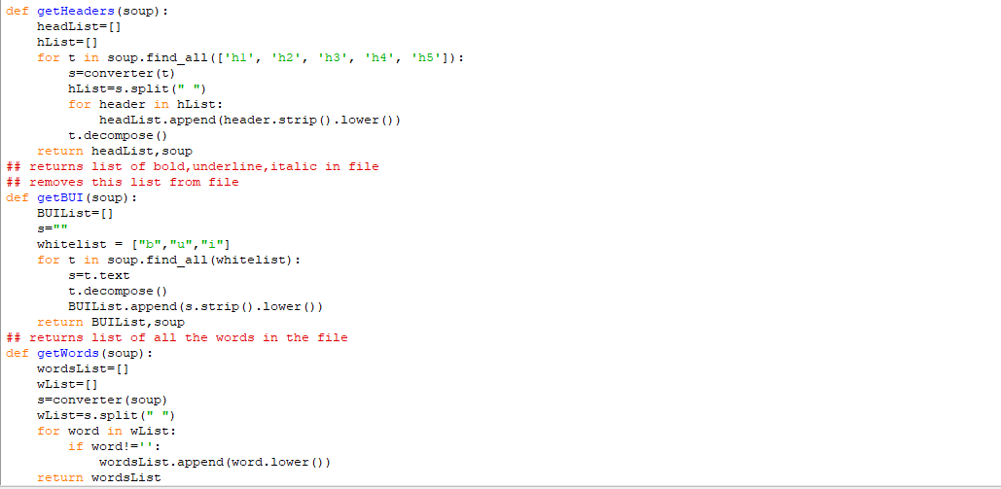
Parser (continued)

Slide 9
Forward vs Reverse Indexing:
Forward Indexing
Reverse Indexing
Directs you from document to word
Fast Indexing
Slow/Difficult search
Directs you from word to document
Slow Indexing
Fast search
Both are used to search text in document or a set of documents.

Slide 10
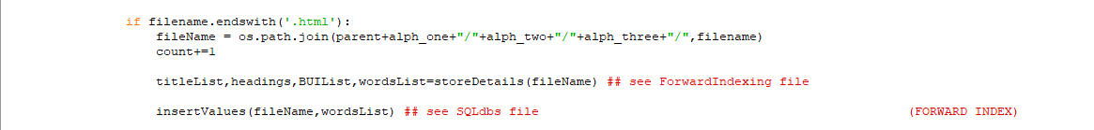
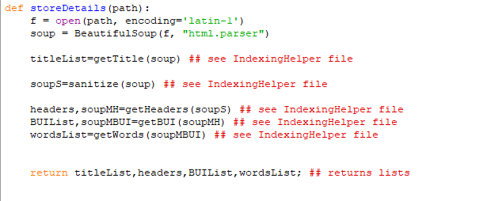
Forward Indexing
Data structure that stores mapping from documents to words.

Slide 11
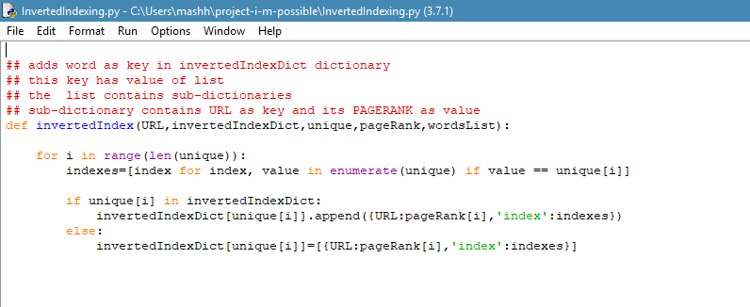
Reverse/Inverted Indexing
Data structure that stores mapping from words to documents or set of documents and prioritize the documents according to some Page Rank.

Slide 12
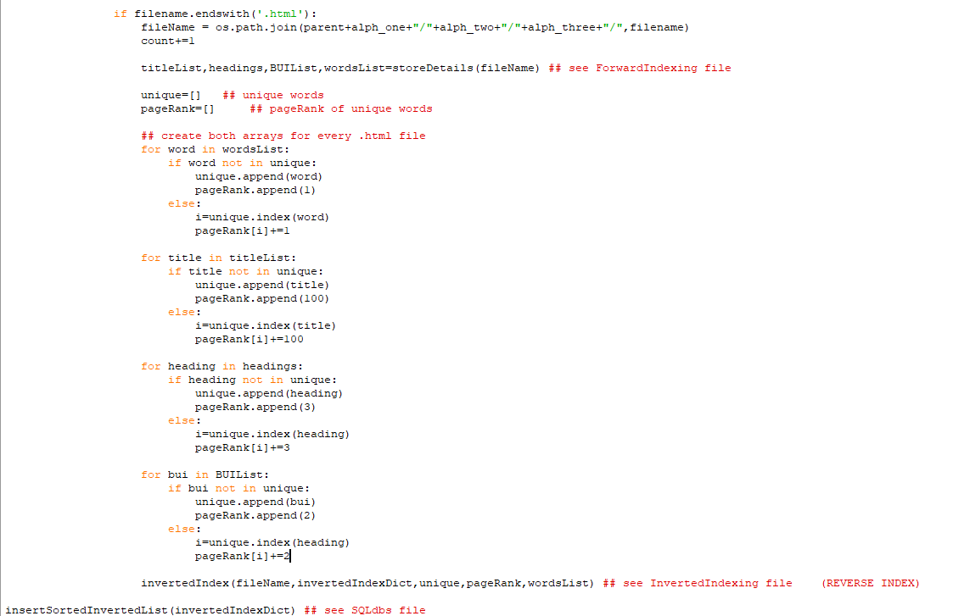
Reverse/ Inverted Indexing

Slide 13
Page Ranking Criteria:
The documents containing a word are scored on the following criteria:
Title has 100 points
Headings have 3 points
Bold/Italic words have 2 points
Simple words have 1 point.

Slide 14
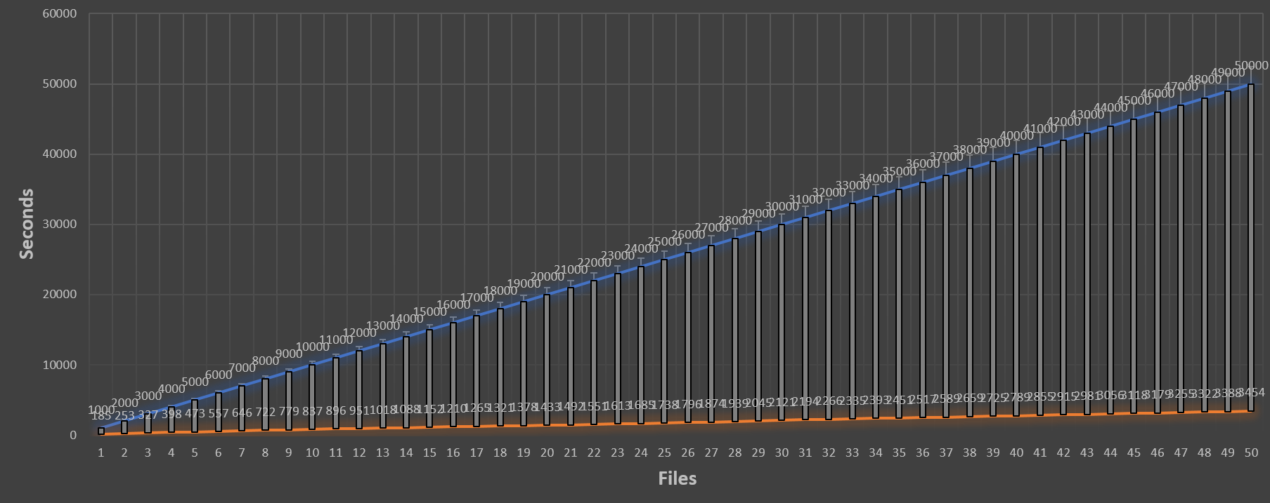
Linear Time Consumption
Time consumption graph for reverse indexing:

Slide 15
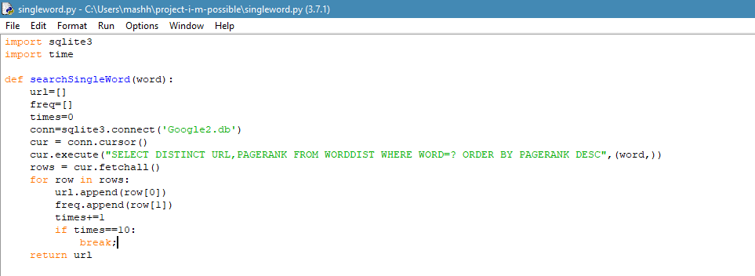
Single Word Searching

Slide 16
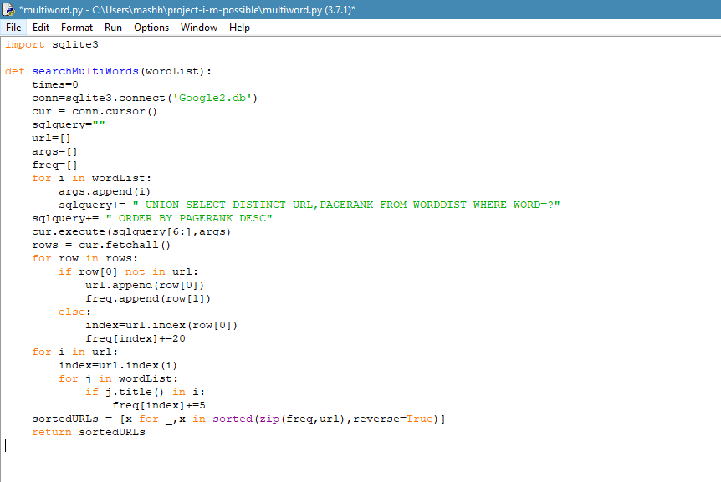
Multiple Words Searching

Slide 17
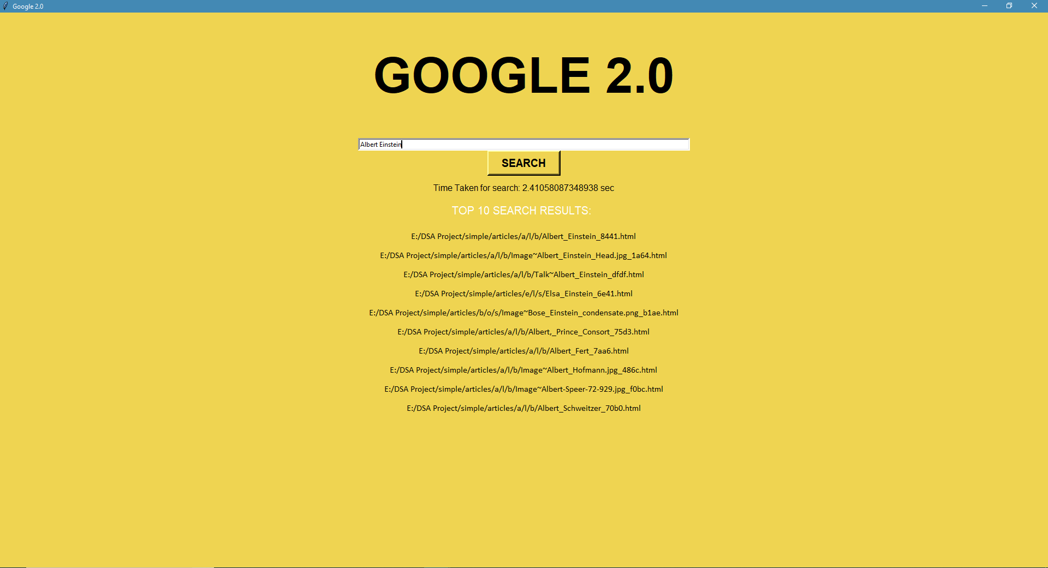
Graphical User Interface

Slide 18
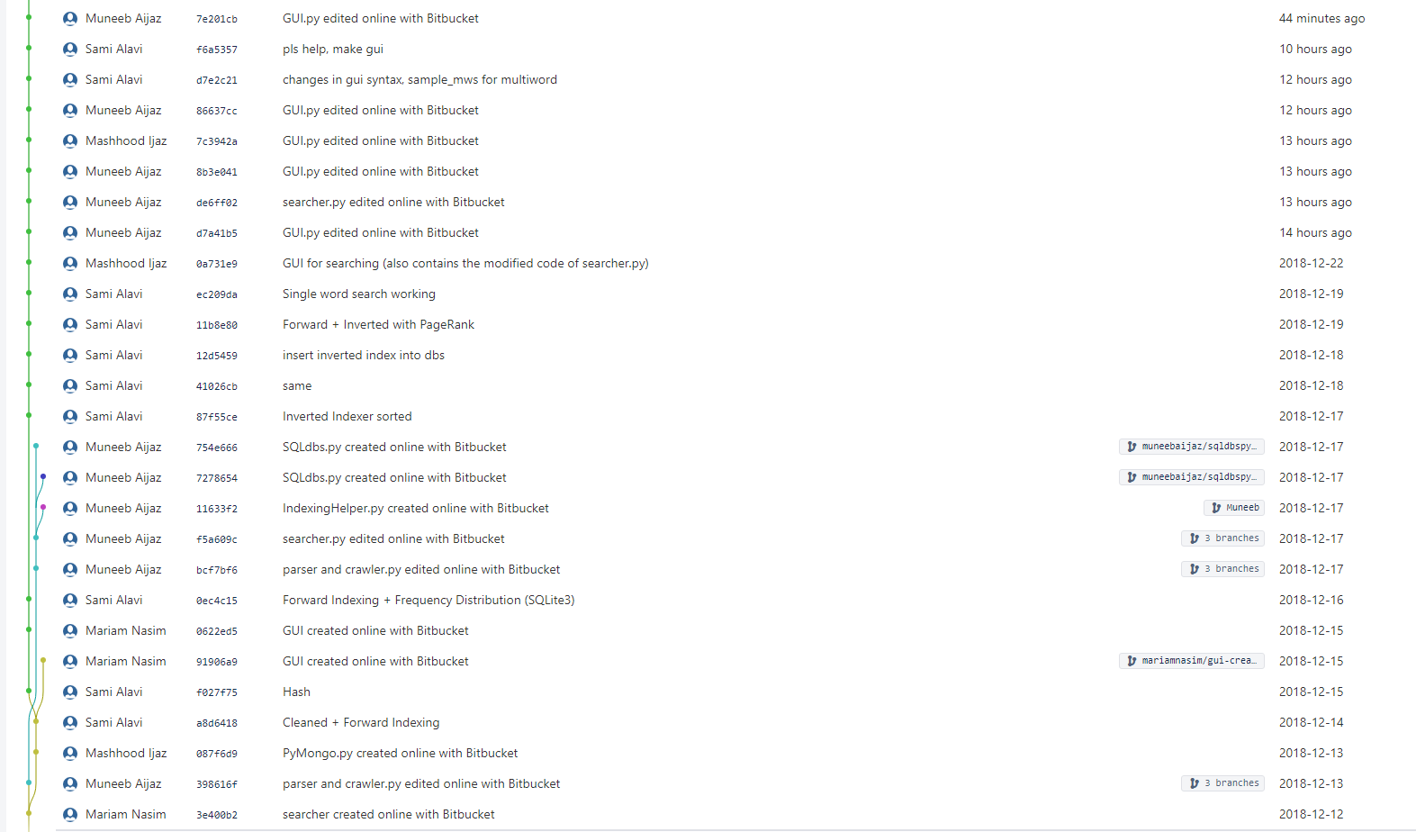
Commit History on BitBucket.org

Slide 19
